Slide 1

DEPLOY WORDPRESS
N.Yashwanth Naidu

Slide 2
INTRODUCTION TO WORDPRESS
WordPress is a popular content management system (CMS) used to create and manage websites without needing extensive coding knowledge.
Open-source CMS (Content Management System).
Used to build websites and blogs.
No coding required for basic use.
Purpose of the Project:
Deploy WordPress using various methods like AWS RDS, Docker, Jenkins, EC2, and Terraform.

Slide 3
Project Overview
Deployed WordPress using AWS RDS (MySQL) and EC2 manually.
Automated deployment using Docker Compose.
Integrated Git and Jenkins for automated build and deployment processes.
Used EC2 User Data scripts for streamlined WordPress deployment.
Automated deployments via Jenkins Execute Shell with bash scripts.
Created Jenkins pipelines with build triggers (poll SCM, periodic builds).
Provisioned EC2 instances with Terraform, automating infrastructure setup.
Integrated Git, Jenkins, and Terraform for continuous delivery.
Managed deployments using Kubernetes with Docker Hub images.

Slide 4
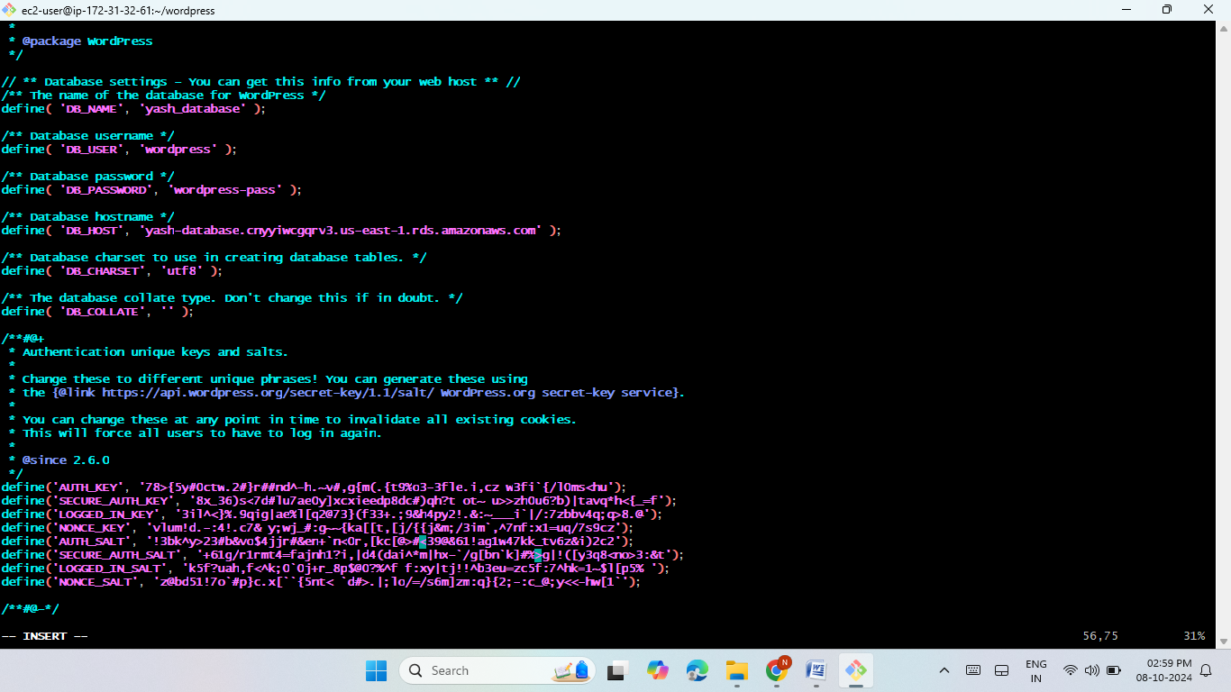
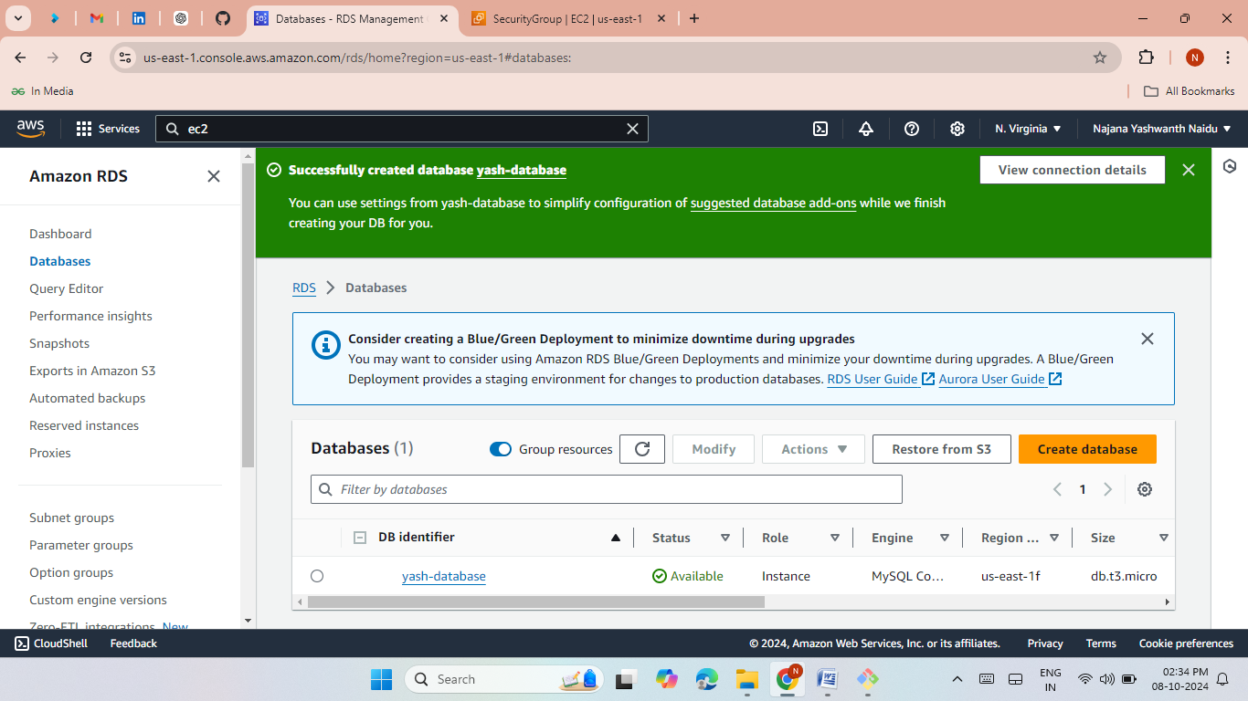
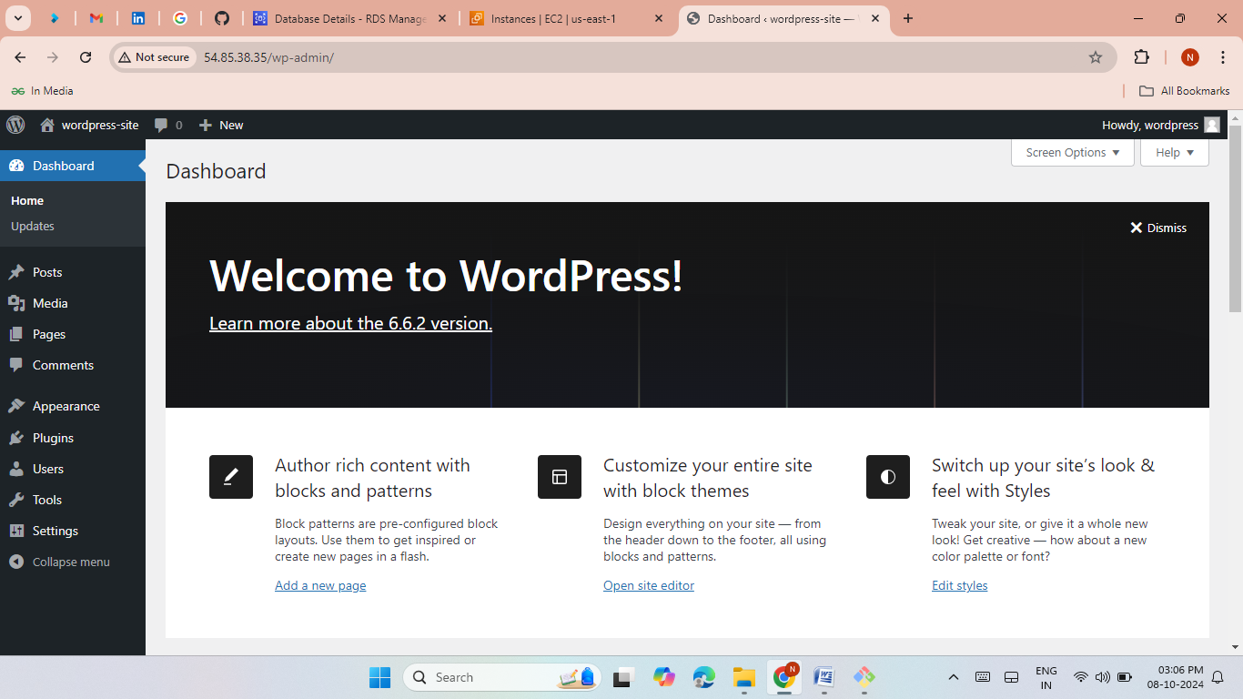
Method 1: Deploy WordPress using AWS RDS
Use AWS RDS (MySQL) for database setup.
Launch EC2 instance and connect via GitBash.
Install necessary services: HTTPD, MySQL, WordPress.
Make the wordpress configuration.
Access WordPress via browser using the public IP.

Slide 5
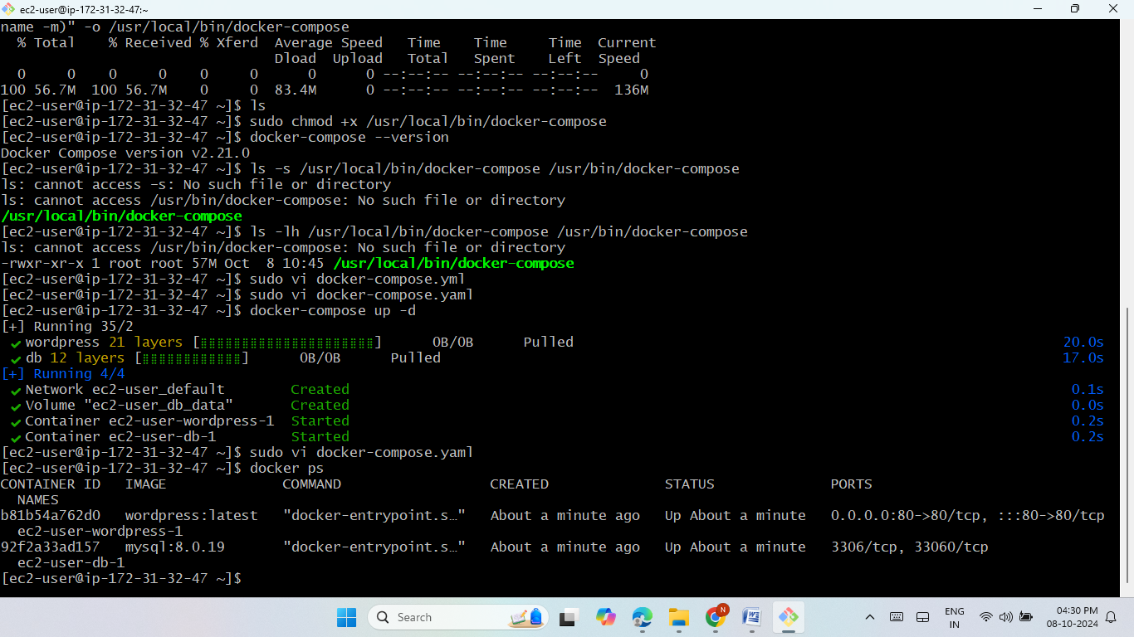
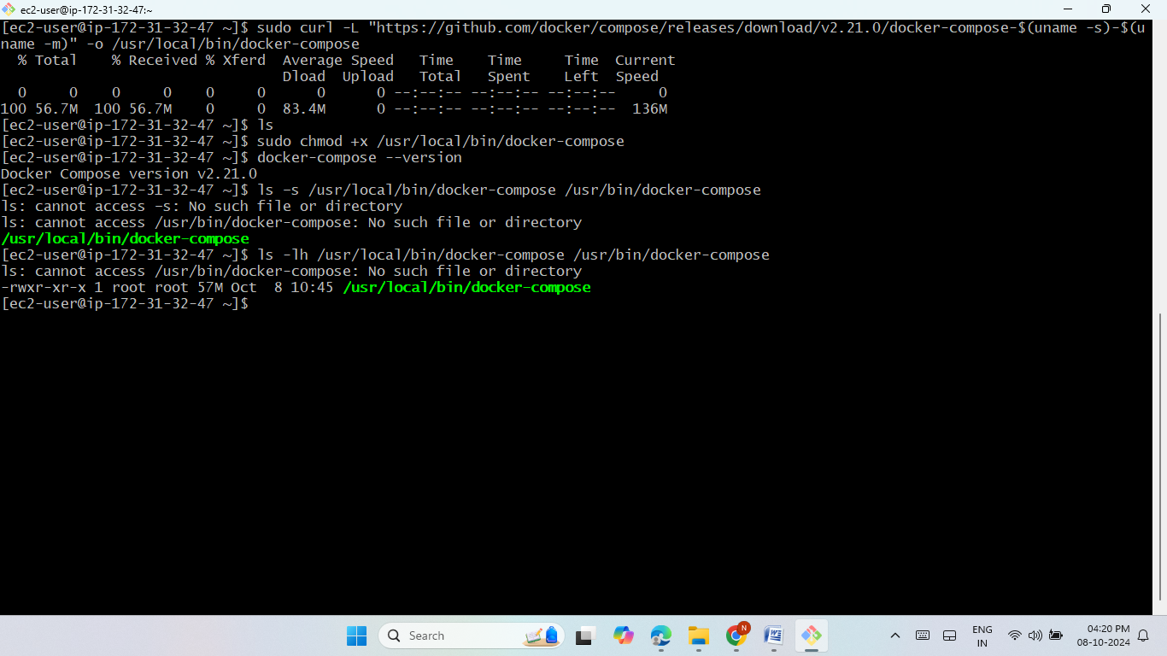
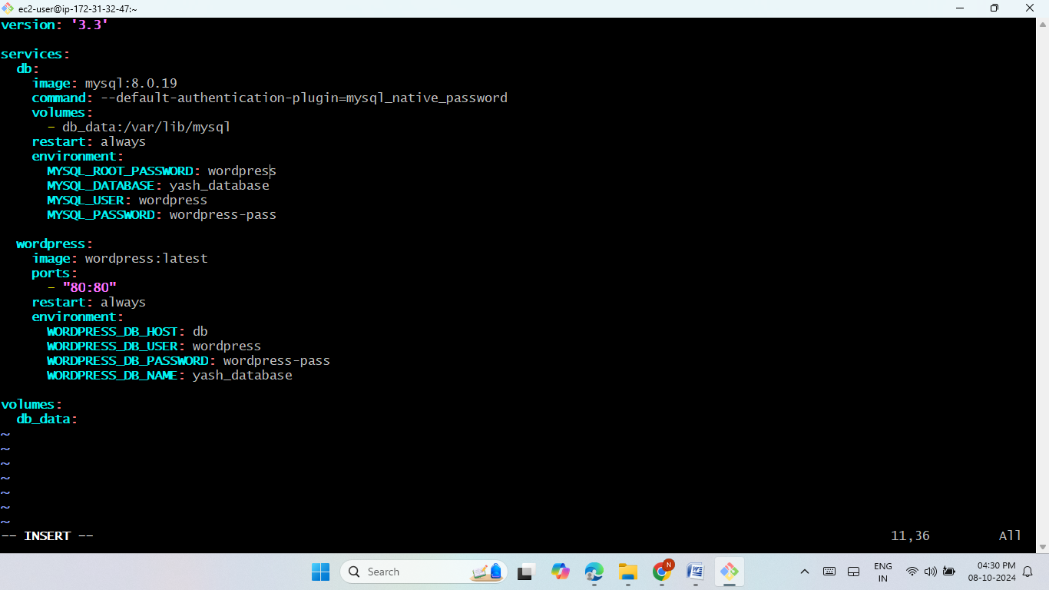

Method 2: Docker Compose
Install Docker and Docker Compose on EC2 then give permissions.
Create a docker-compose.yml file to pull WordPress and MySQL images.
Deploy WordPress by running the containers.
Access WordPress via the public IP.

Slide 6
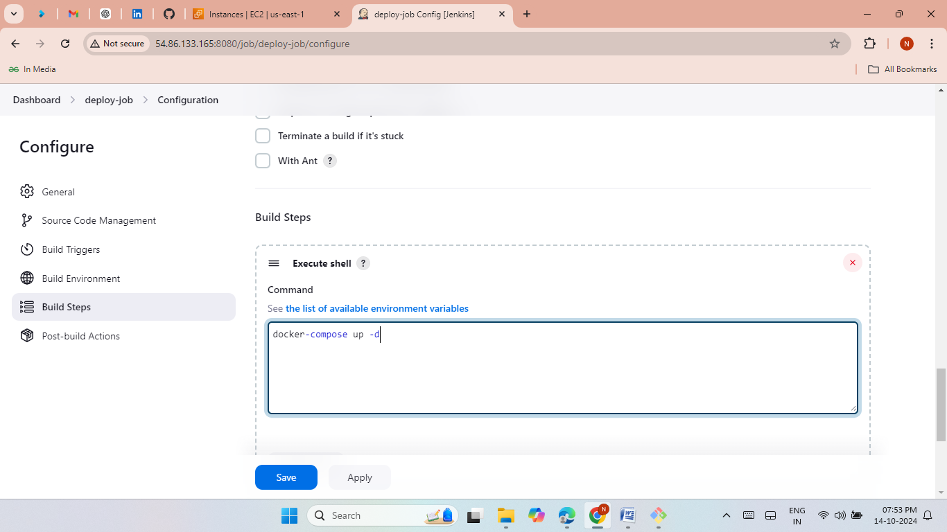
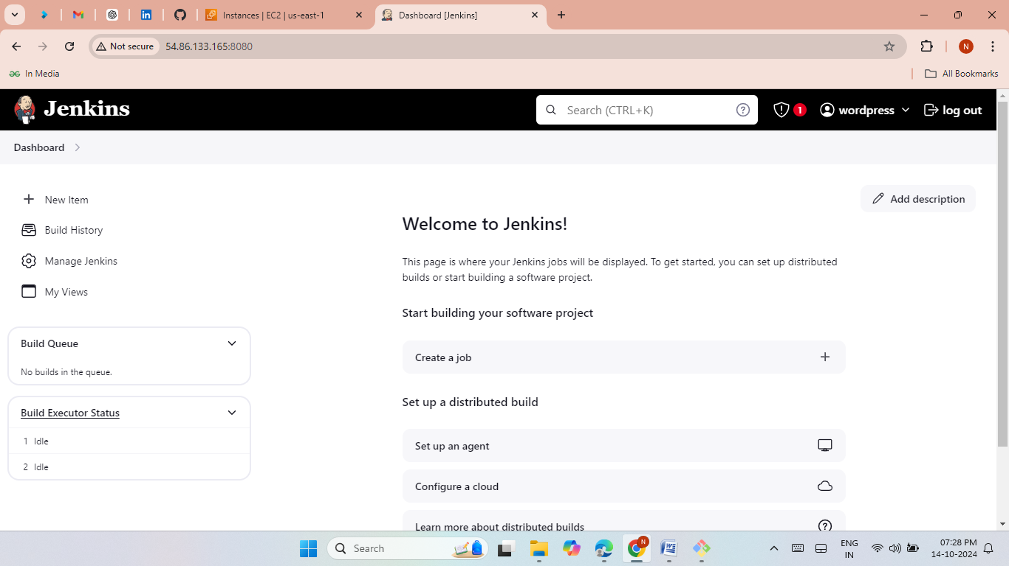
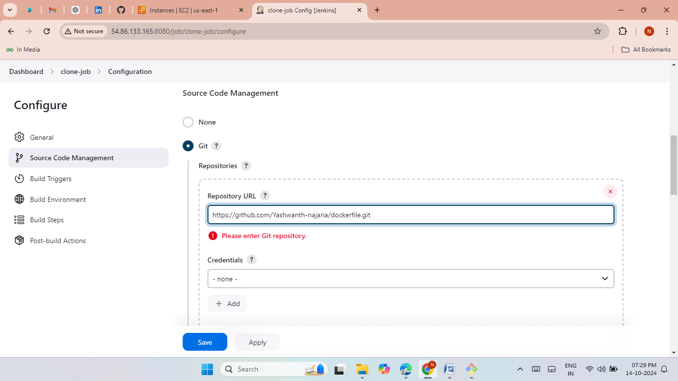

Method 3: Jenkins Integration
Install Jenkins and set up Docker.
Clone Git repository using Jenkins.
Automate deployment by running Docker containers via Jenkins jobs.
Access WordPress via the public IP.

Slide 7
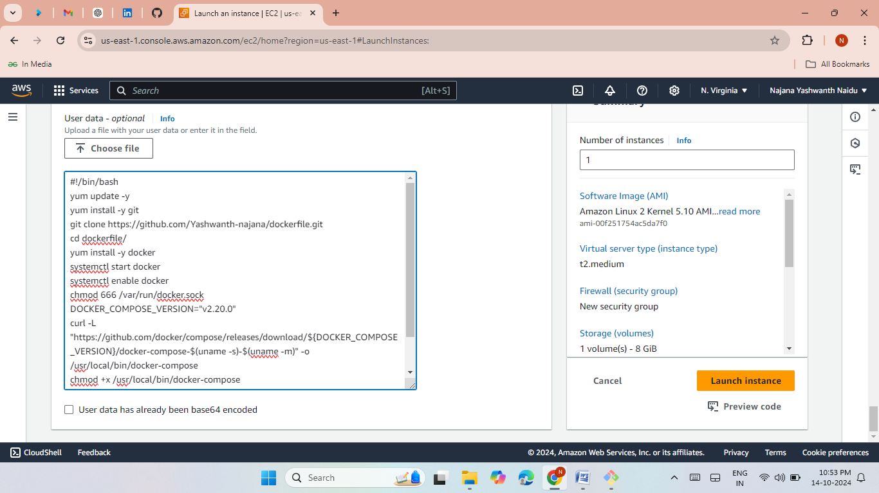
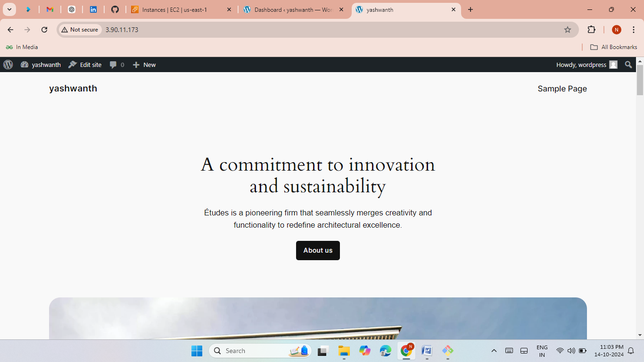
Method 4: EC2 User Data
Write and deploy a bash script in EC2 User Data.
Automate the entire setup for Docker and WordPress.
Launch WordPress automatically on instance creation.

Slide 8
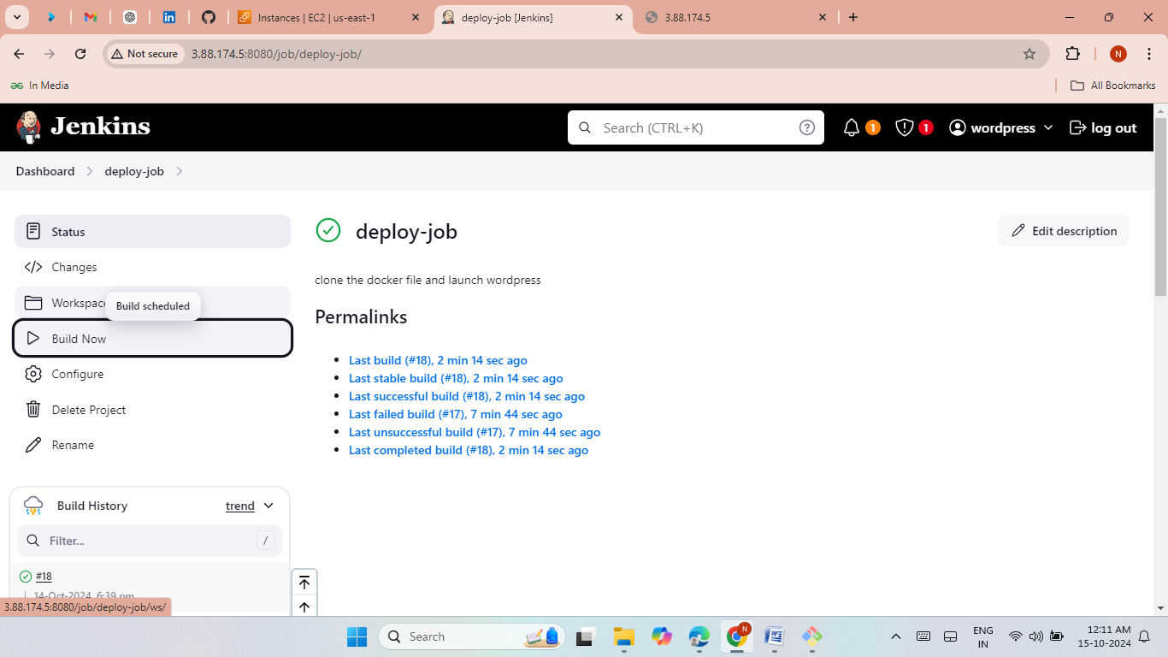
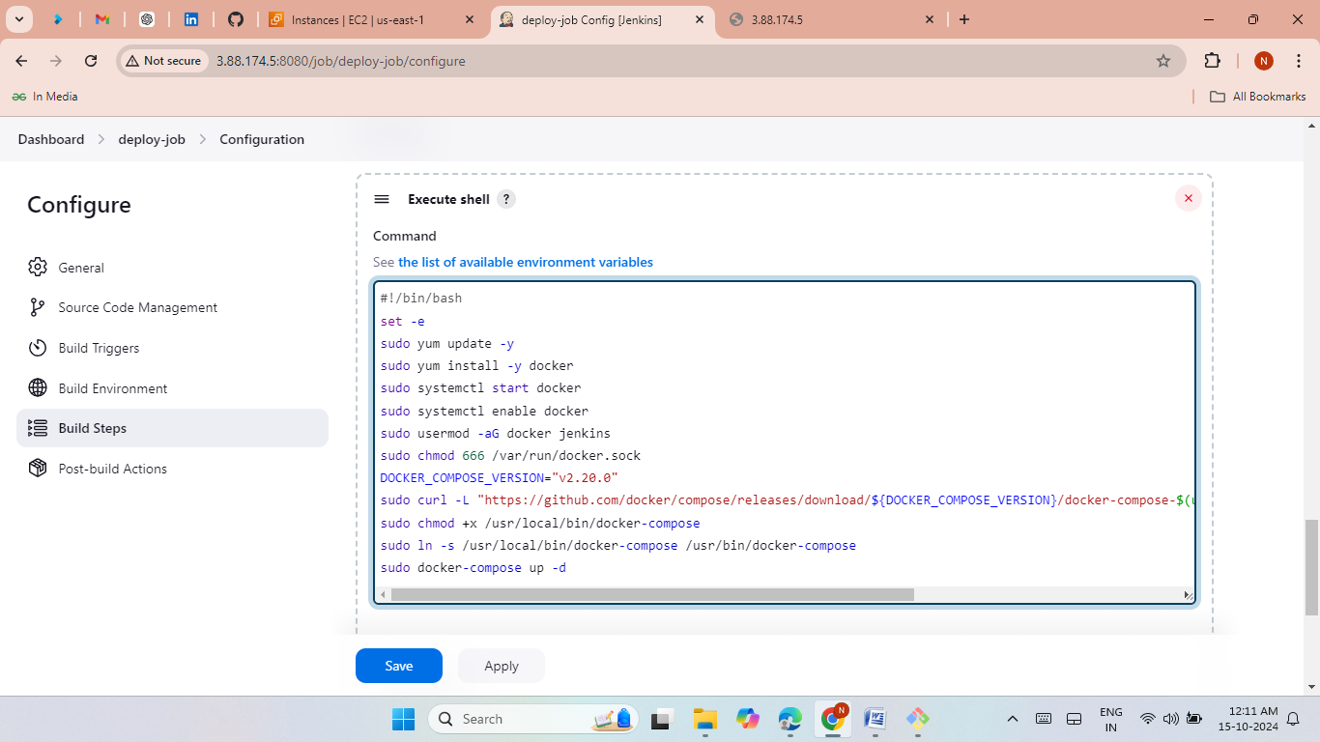

Method 5: Git & Jenkins Bash Script
Launch EC2 instance with Jenkins.
Use Jenkins to execute a bash script to deploy Docker and WordPress.
Automate using Git repository and Jenkins jobs.

Slide 9
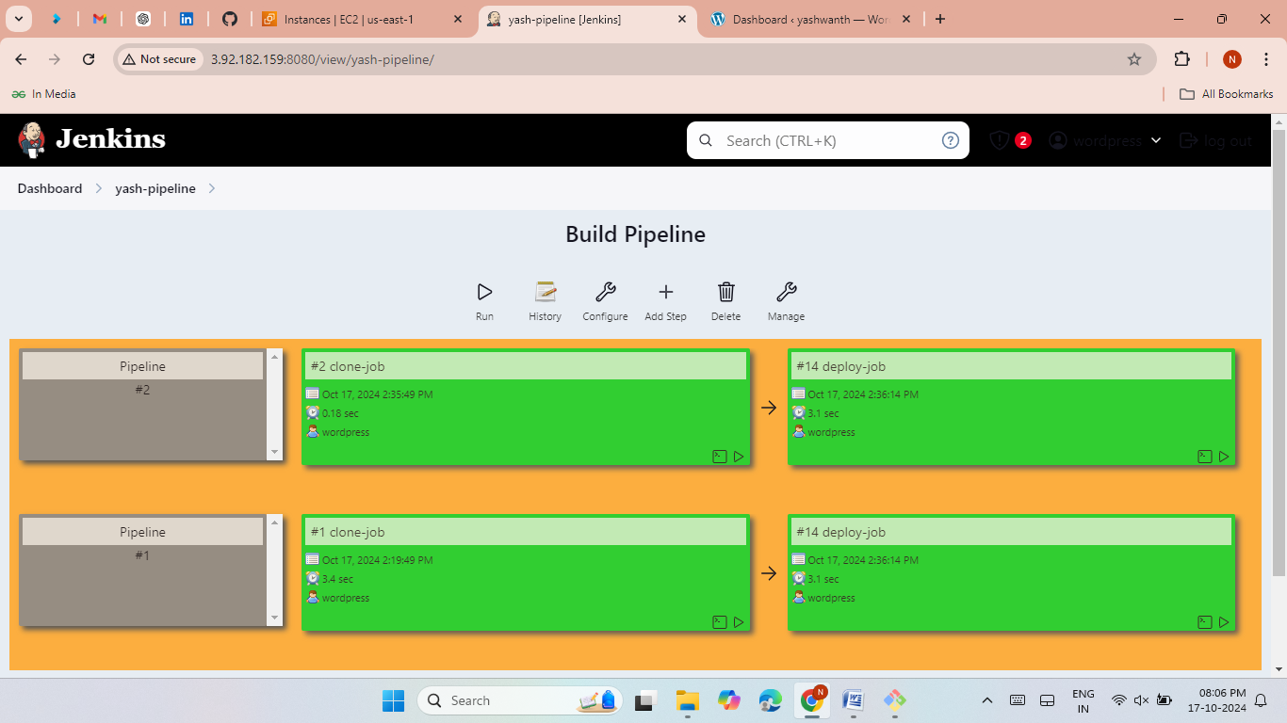
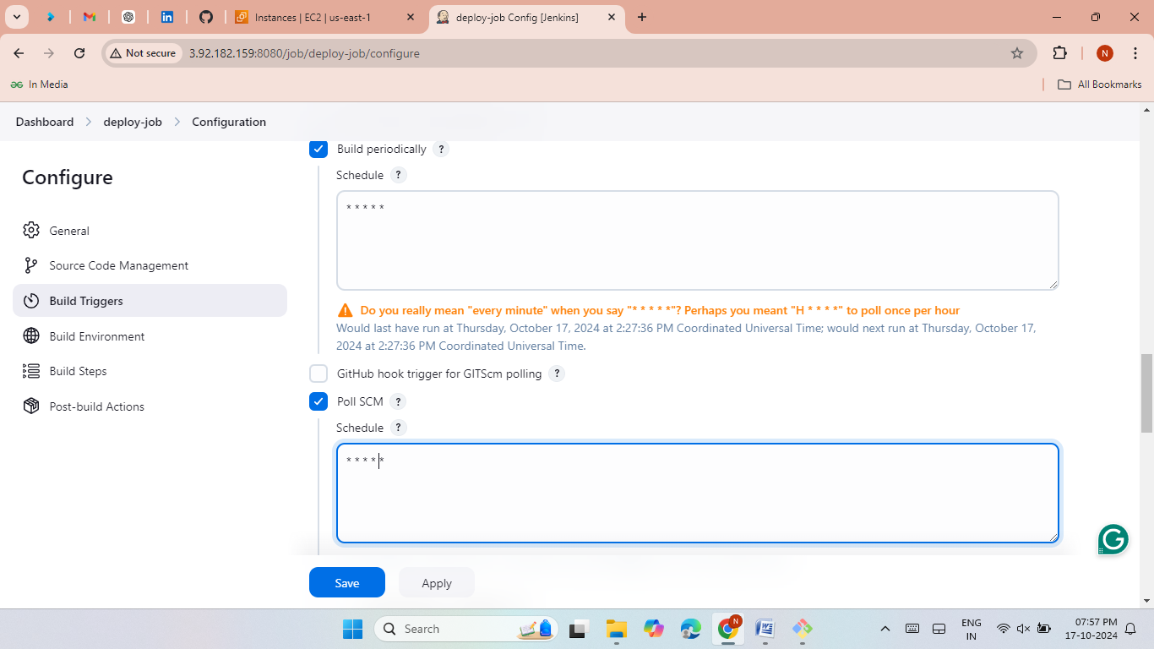
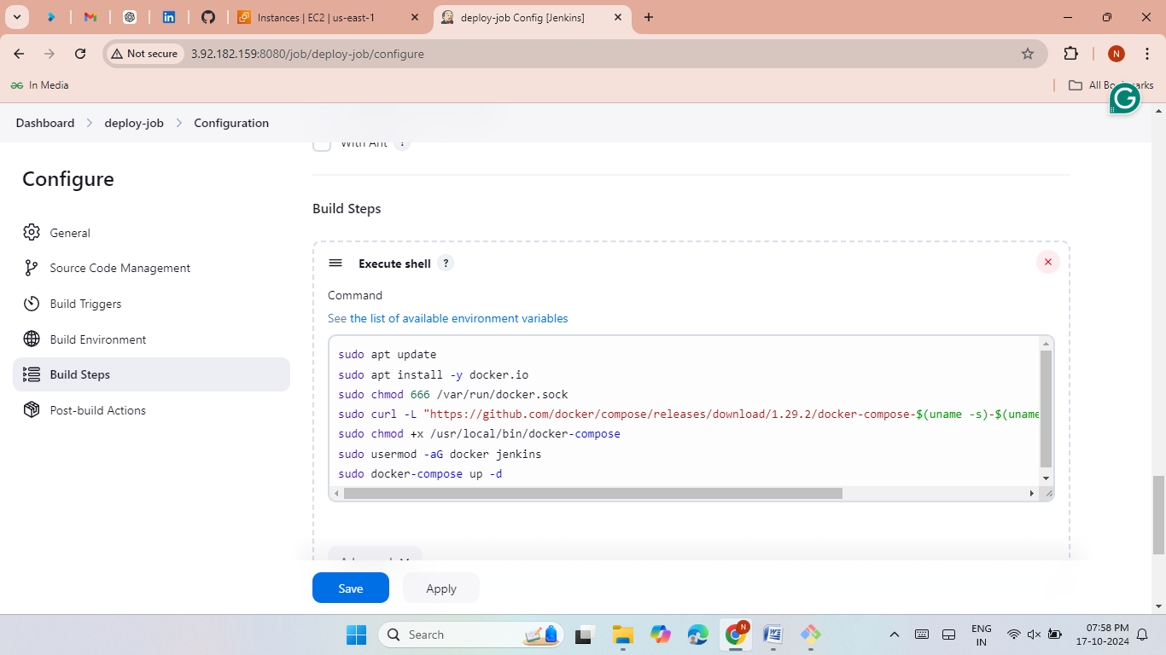

Method 6: Jenkins Pipeline
Create a Jenkins pipeline with build periodically and poll SCM Schedules.
Clone WordPress deployment script from GitHub.
Automate deployment via pipeline and monitor changes.
Wordpress runs every min.

Slide 10
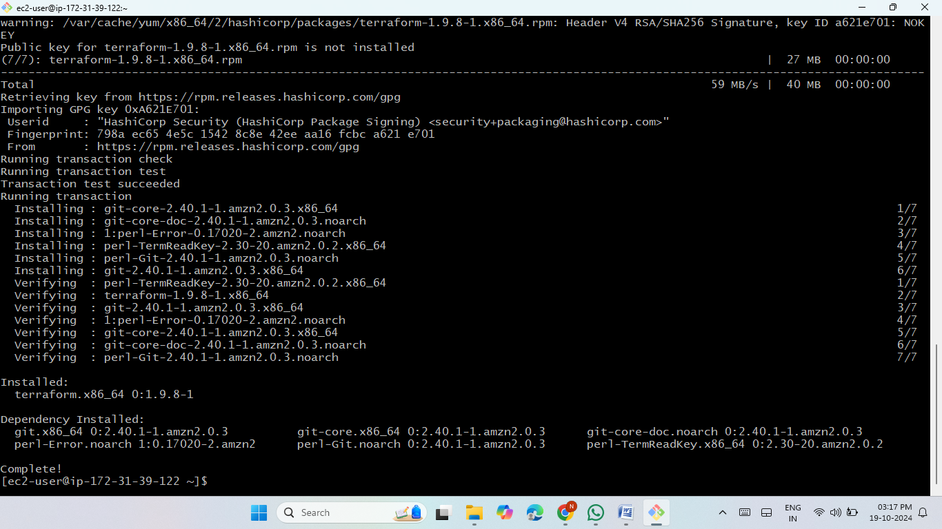
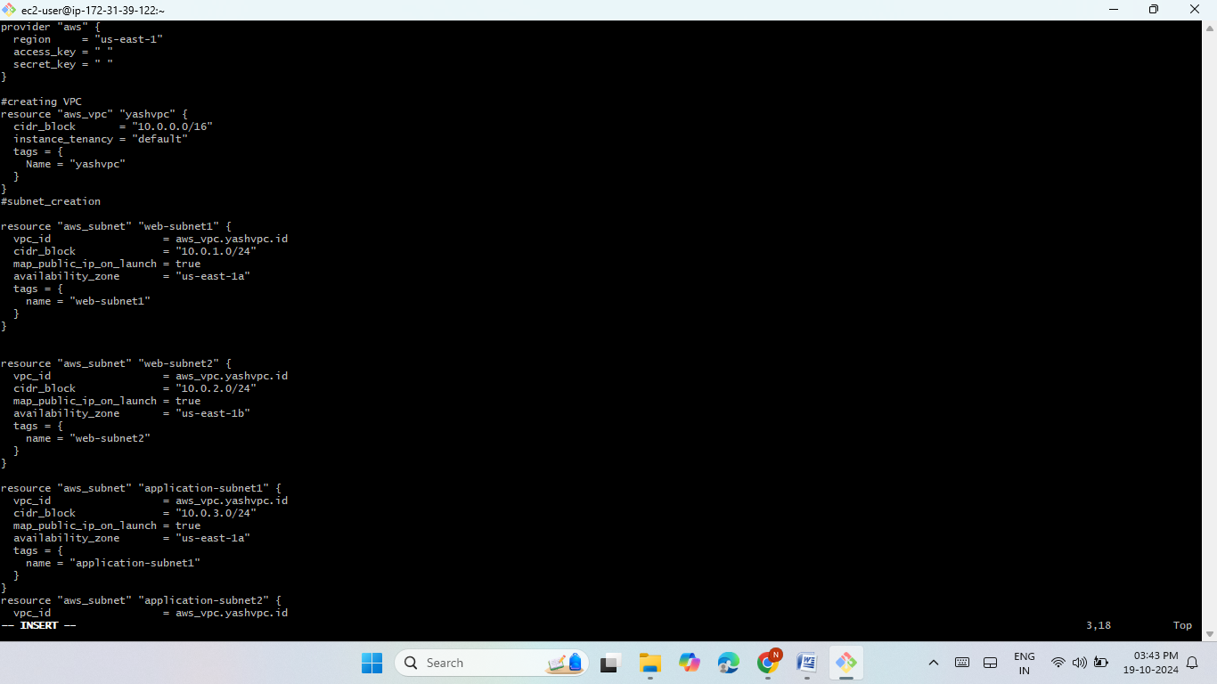
Method 7: Terraform Setup
Install and configure Terraform on EC2.
Write Terraform script to launch EC2 instance and required resources like vpc, subnets, route, internet gateway, security group.
Run the terraform with the terraform commands.
Use Terraform to automate deployment of WordPress.

Slide 11
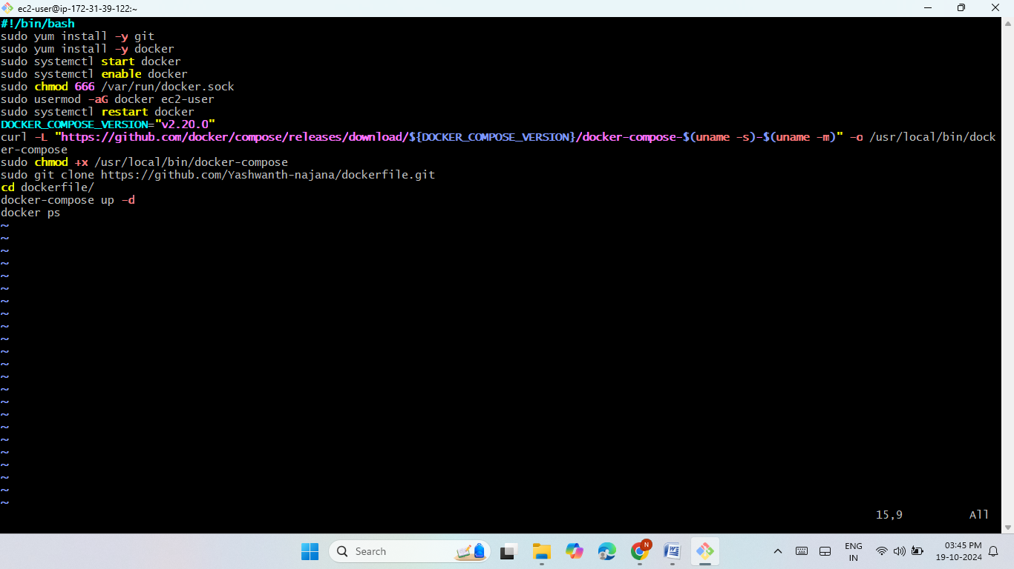
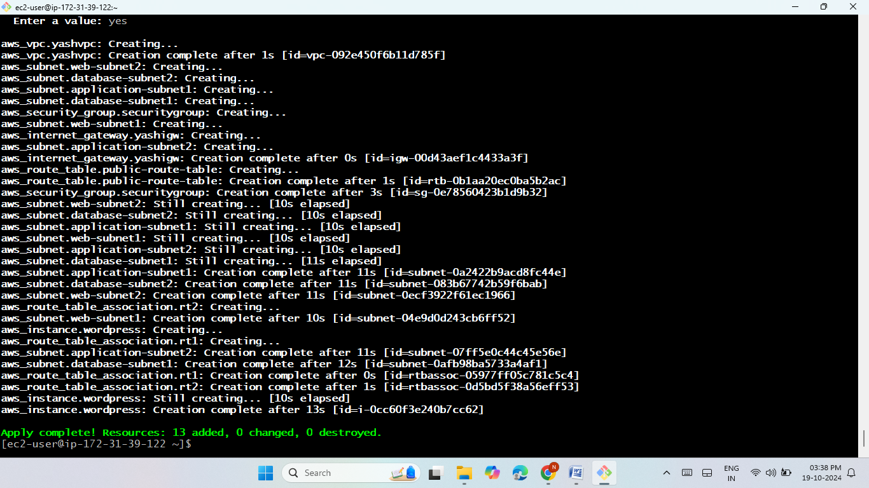
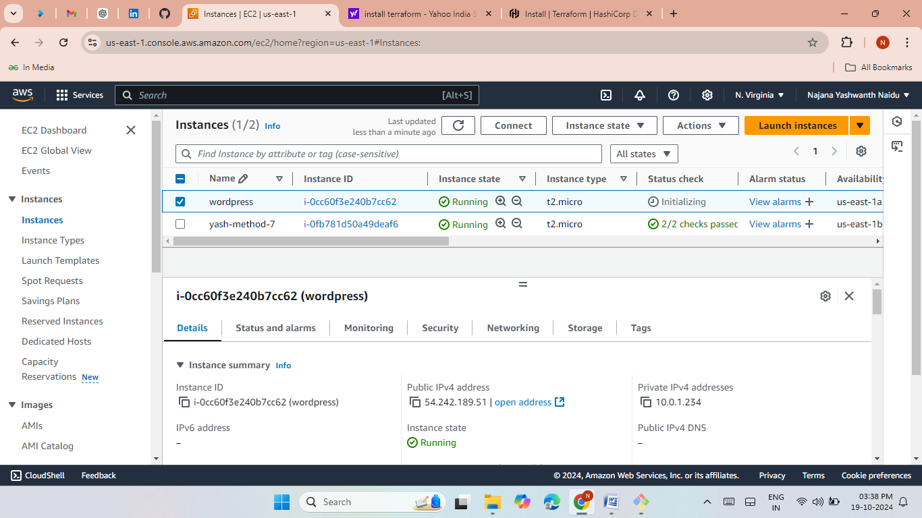
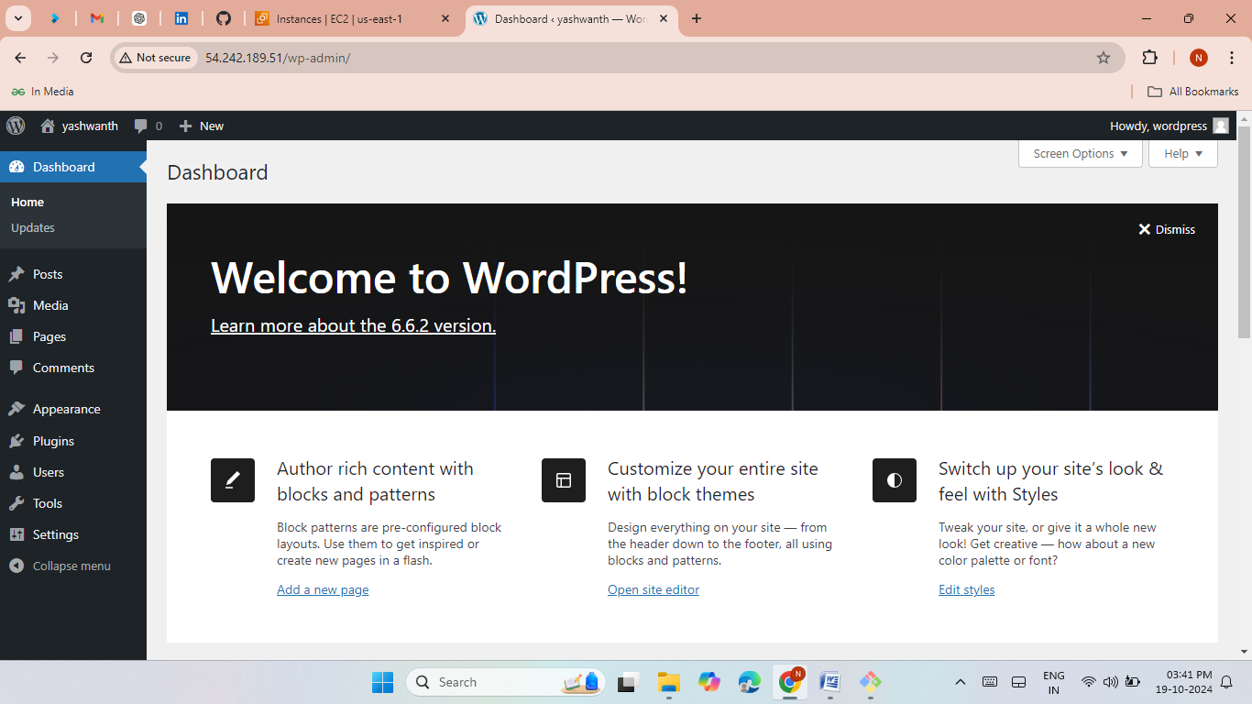

Slide 12
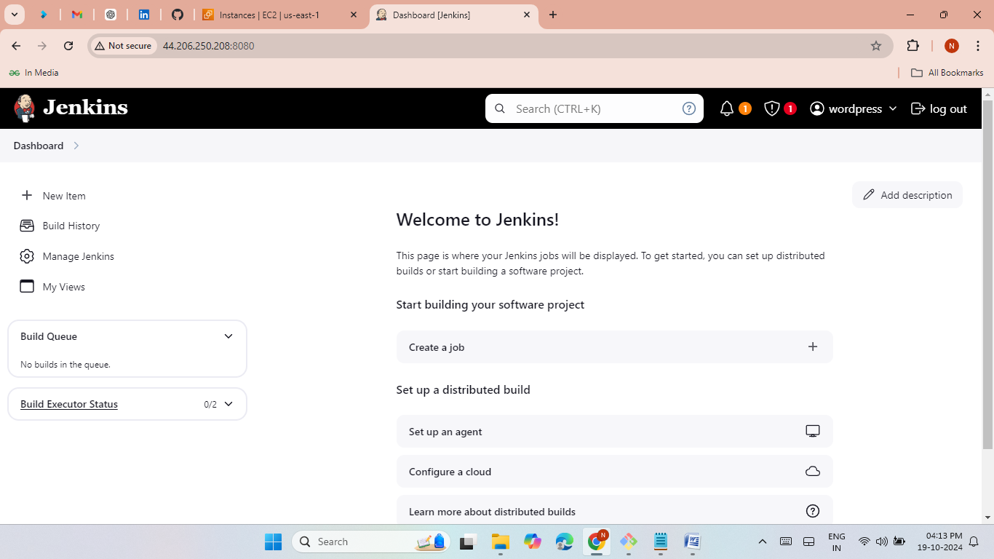
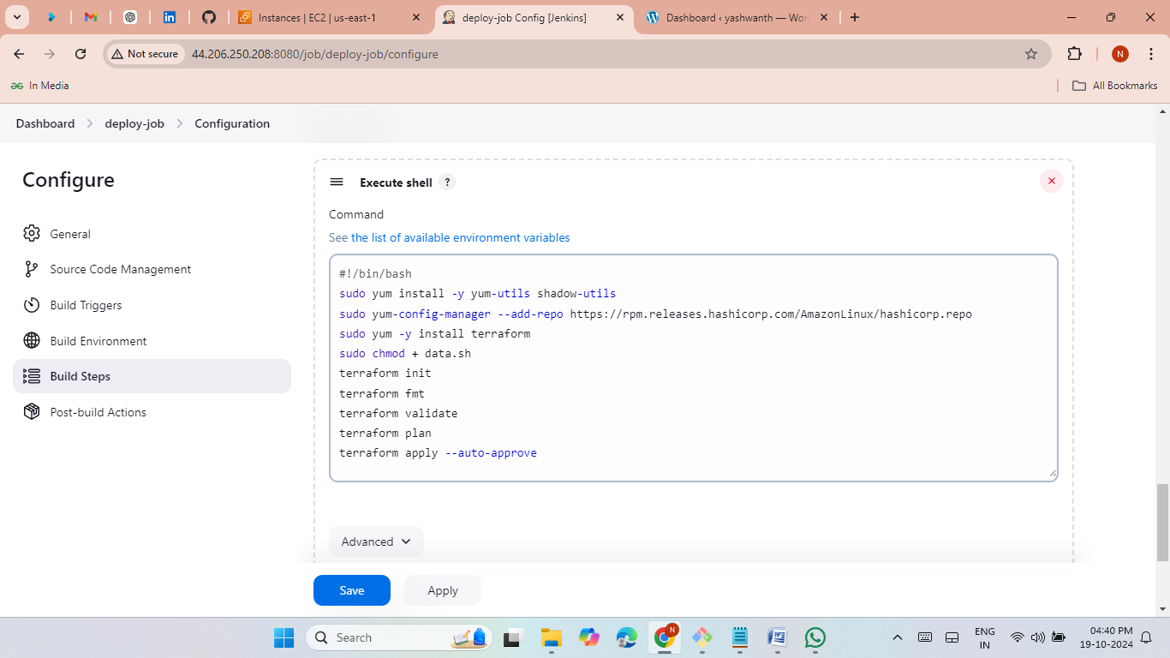

Method 8: Git, Jenkins, and Terraform
Launch EC2 and install jenkins in gitbash.
Clone Terraform scripts in Jenkins.
Install AWS credentials and add in created job.
Install Terraform via Jenkins and automate WordPress deployment.
Continuous delivery with build automation.

Slide 13
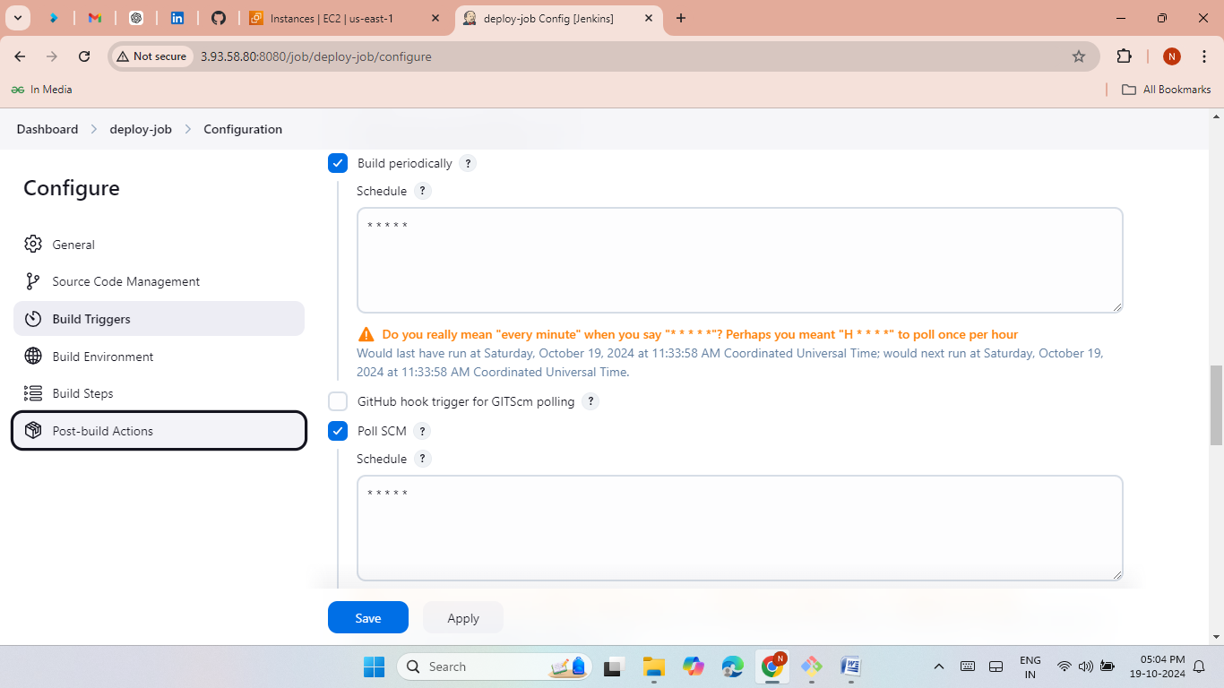
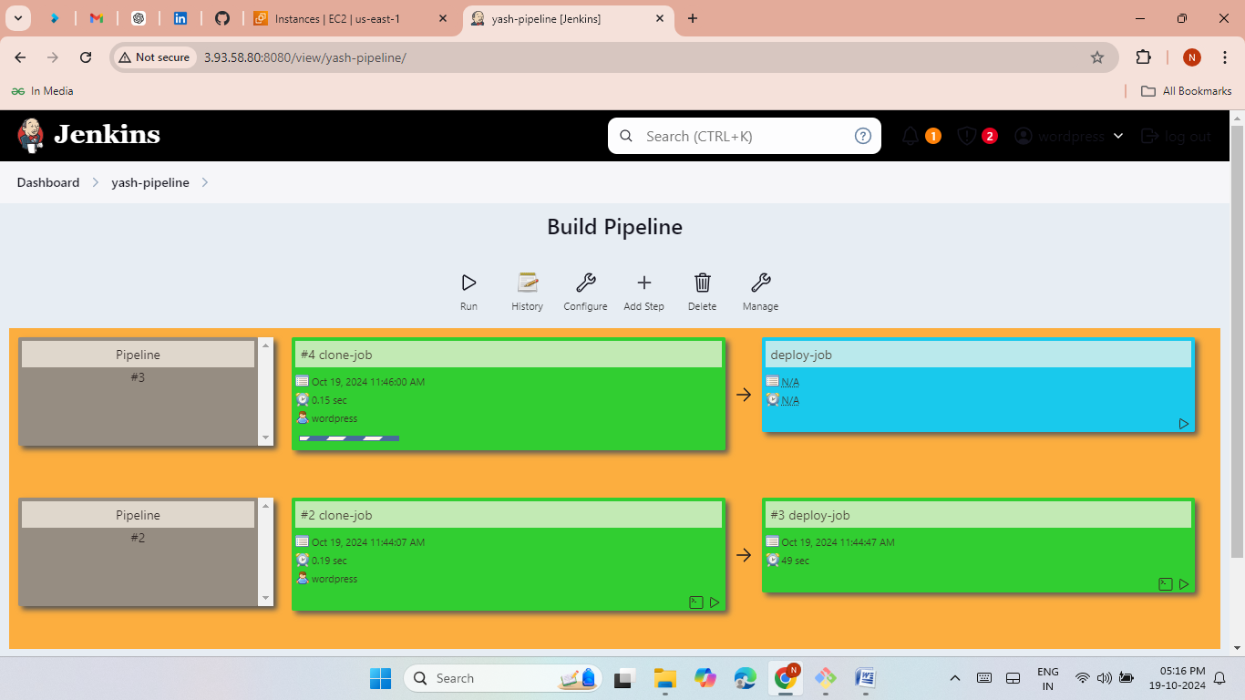
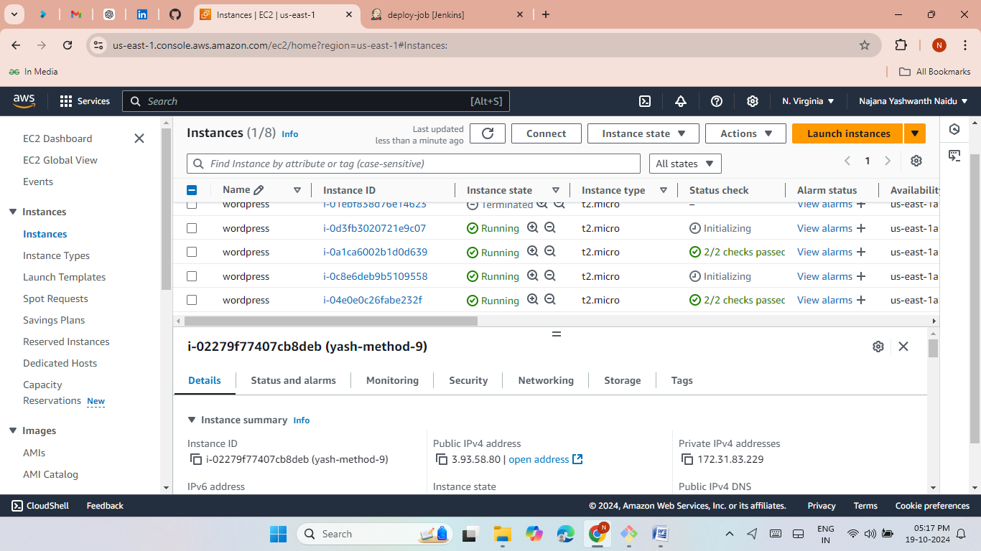

Method 9: Jenkins Pipeline with Terraform
Set up periodic builds and SCM polling in Jenkins pipeline.
Automatically trigger Terraform deployments with Jenkins jobs.

Slide 14
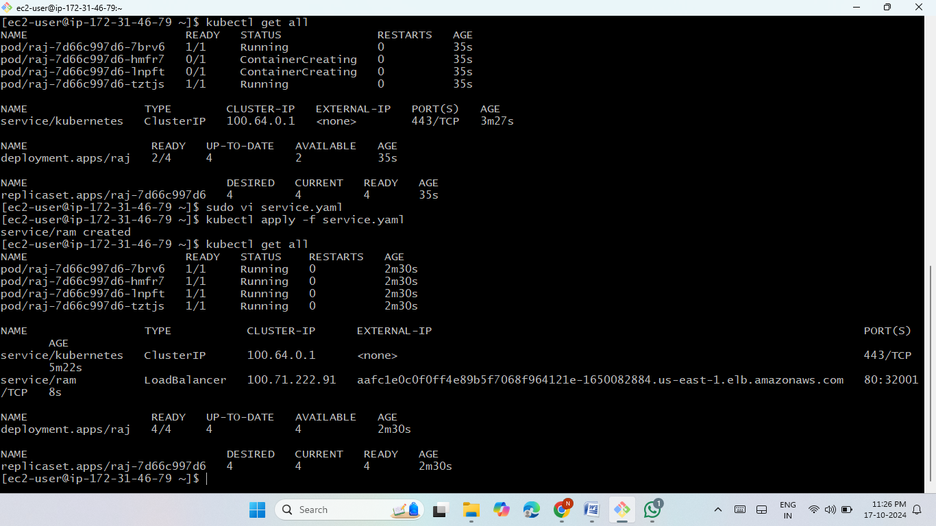
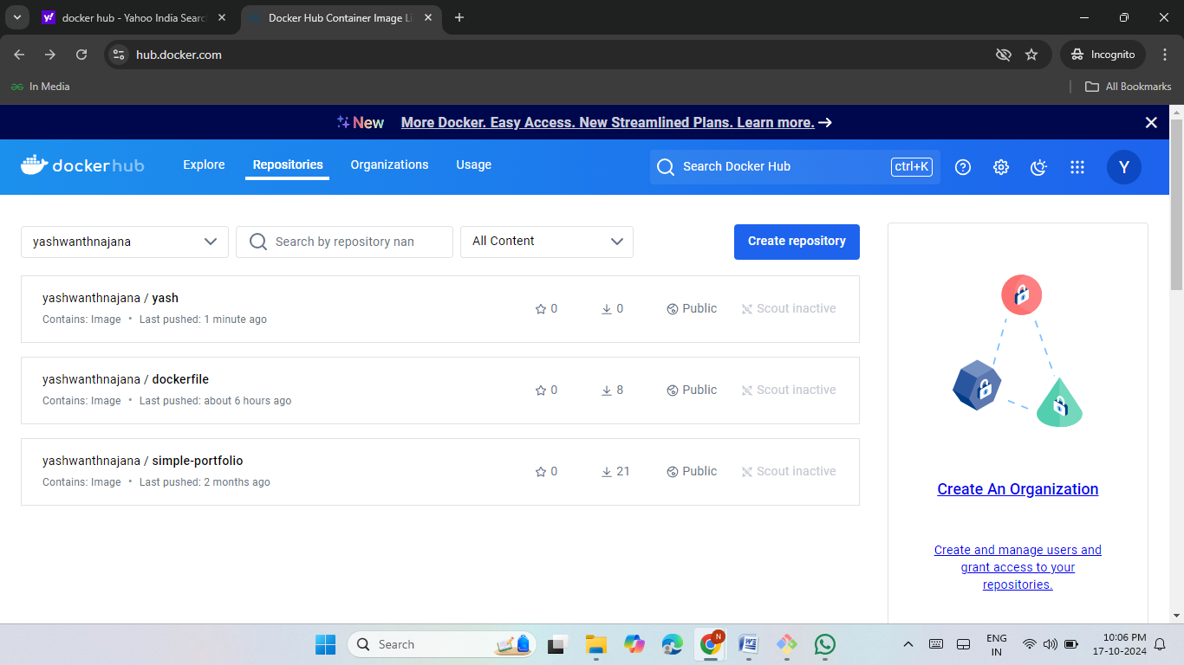
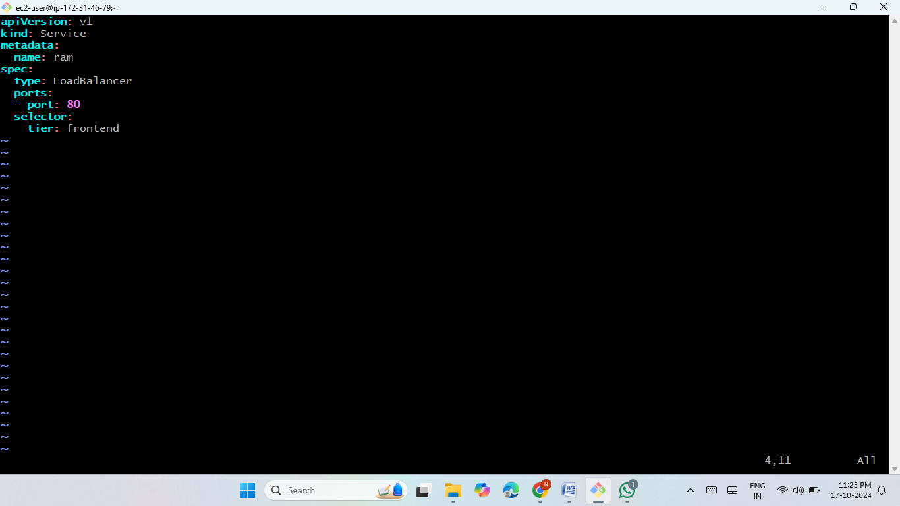
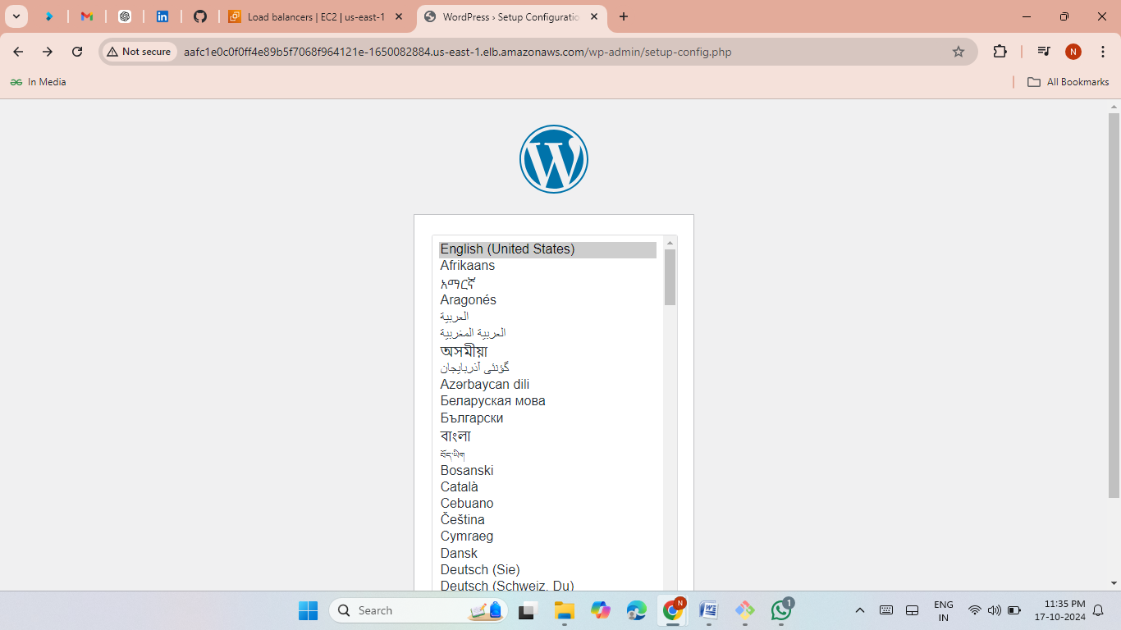
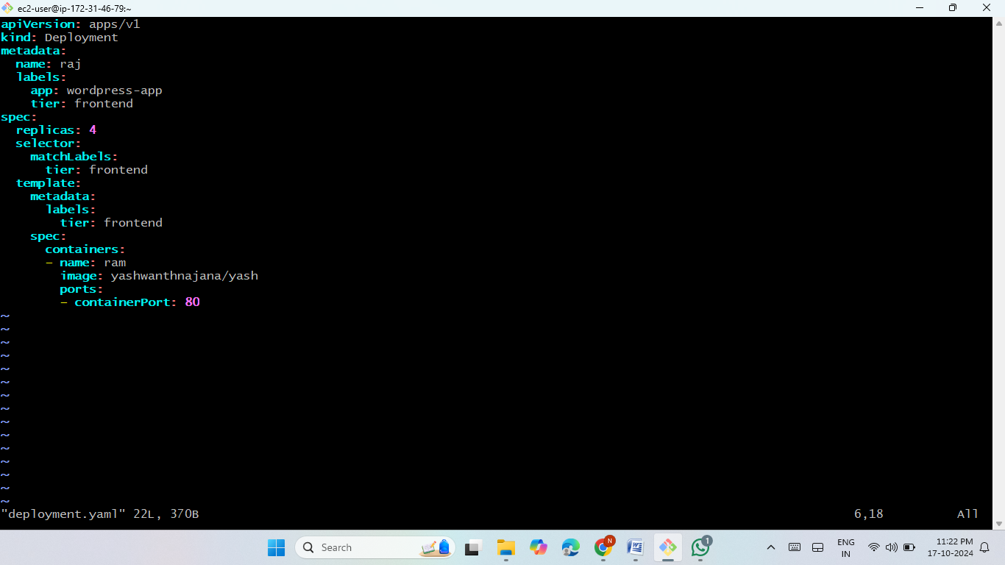
Method 10: Kubernetes (K8s) Deployment
Push WordPress Docker images to Docker Hub.
Use Kubernetes manifest files to deploy WordPress.
Use LoadBalancer to access WordPress via DNS link.

Slide 15
Thank you

